Slide 1





A Safer Place
A Better Feel To the Place
A Well Connected Place
An Eco Friendly Place
An Equal and Diverse Place
An Effective Council
A Place To Do Business.
Action Plan 25/26
Supporting Wellbeing Within SWAN
Who SWANCC are working with
2025 2026 Objectives Linked to SWAN Community Plan Themes
Crime Prevention
Every road in the SWAN Parish now has an active NHW scheme. Monthly reports from NHW at Full Council. Newsletter updates sent at least 3 times a year in SWAN News
Speeding
Mobile Speed Indicator device grant funding secured and submitted to KCC. Due to COVID-19 and KCC Highways restructuring, progress on the SWAN Highways improvement plan began in September 2023. Five sites were submitted for review, with the device expected to rotate across locations in SWAN by 2025.
Play Park Renewal
Bulleid Place New Play Train and Carriages ABC Funded. Stirling Road New Play Equipment ABC Funded, Picnic Table, Bench, Waste Bin, Community Orchard, Planting and Mud Play ABC KCC SWANCC Funded.
Local Physical Improvements
Investigate the possibility of a Flagpole for Newtown Green Subject to Permission, Planning Permission and Consultation
Weekly Litter Picking, Footpath Weeding, Spraying and Tidying, Cleaning Street Road Signs and Maintaining Street Furniture, Increasing Litter Bins, Replacing Benches.
Planting and Biodiversity Improvements
7000 Spring Bulb Planting, 60 Dwarf Fruit Trees Kings Coronation Planting Scheme, Adopting and Managing Raised Beds at Alfred Rd, Wainwright Place and Stirling Rd.
Community Allotment with Actions Days for all SWAN residents, Book a Bed scheme with written guide, National Allotment Society Open Day with continuation of Living Workshop, Pick your own Pumpkin Day.
Connectivity and Communiation
Calendar of Events for the SWAN Community , SWAN News delivered to every household 3 times a year. Council Website & Email - .Gov.UK Domain, Social Media, Council Promotion of Council activities, Resident Consultations. Council Publication for events Council branding for effective Communications.
Equality & Diversity is reflected in everything SWANCC does – from employment, policy, decision making, service delivery, meeting venues, to encouraging Local Cllrs and Community Inclusion.
Effective Council Maintaining Agreed Objectives To Achieve Council Quality Award and Clerk CILCA Qualification
Community Hub Working Group to facilitate a Council Building for a Community Hub. The possible transfer of the Clock Tower and Kiln Café. Newtown Enhancements Working Group to action improvements for Newtown and to gather historical data for SWAN Salute.
Rising Cost Support Hygiene Bank and Vegetable Bank within SWAN Salute to the 1940s, Grants for Local Community Groups and Charities.

Slide 2
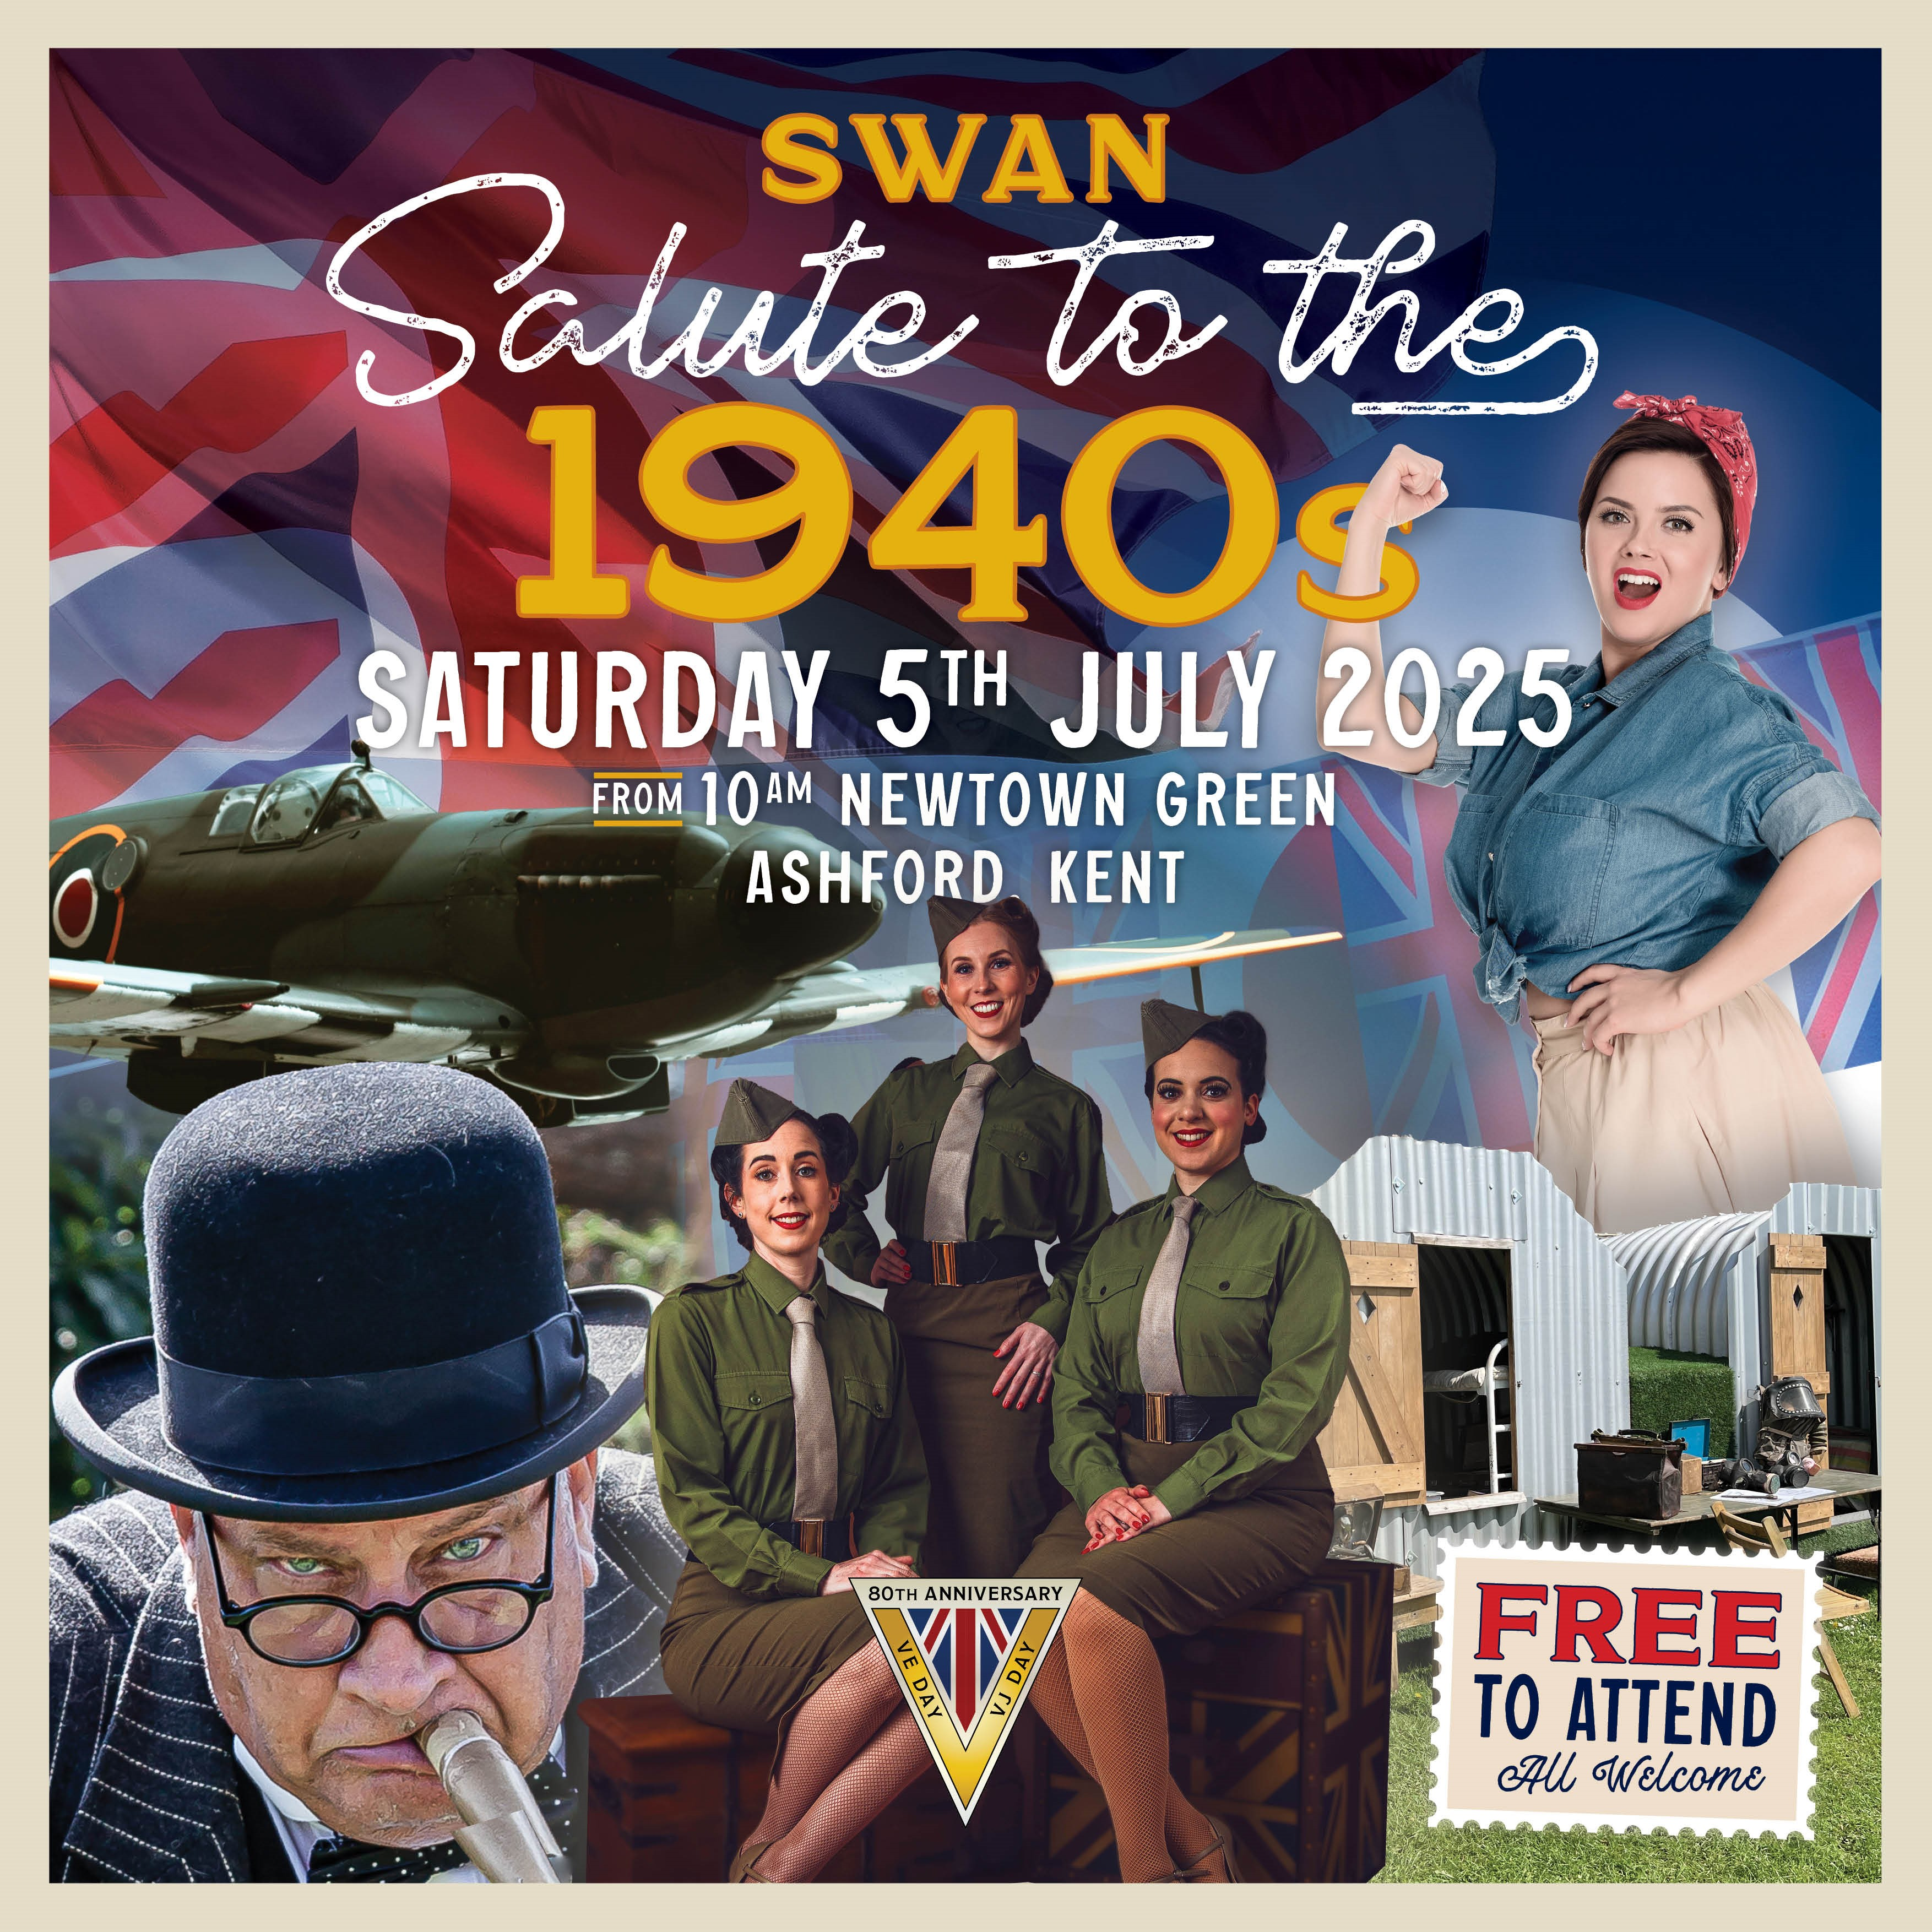
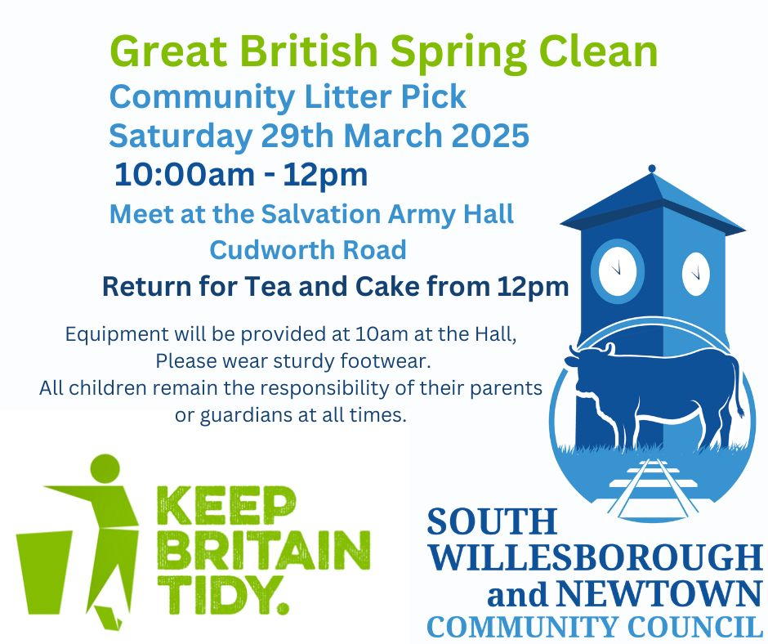
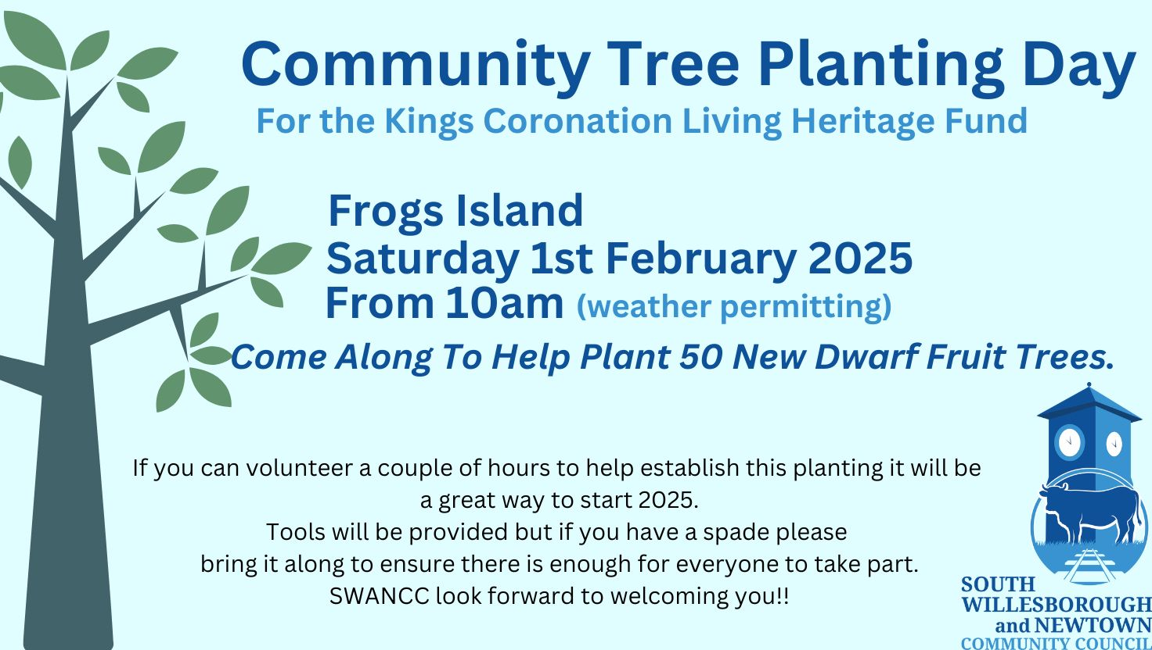

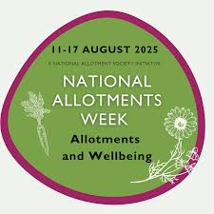
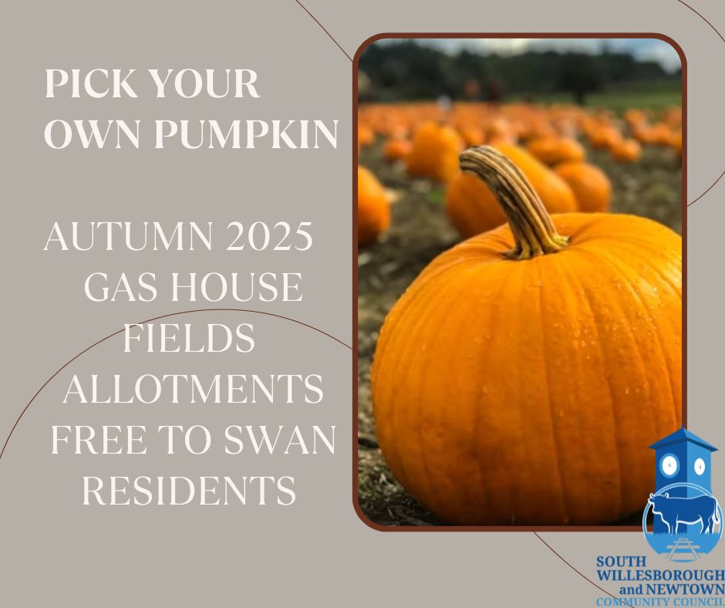
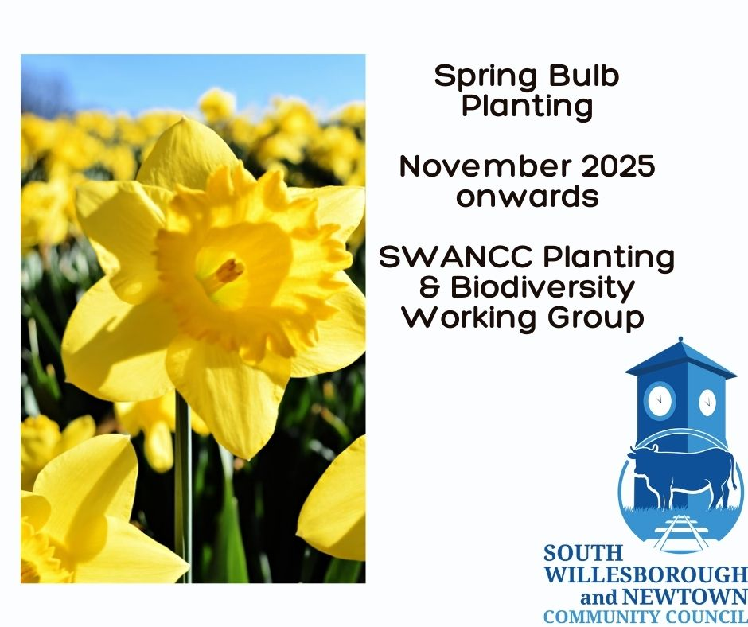
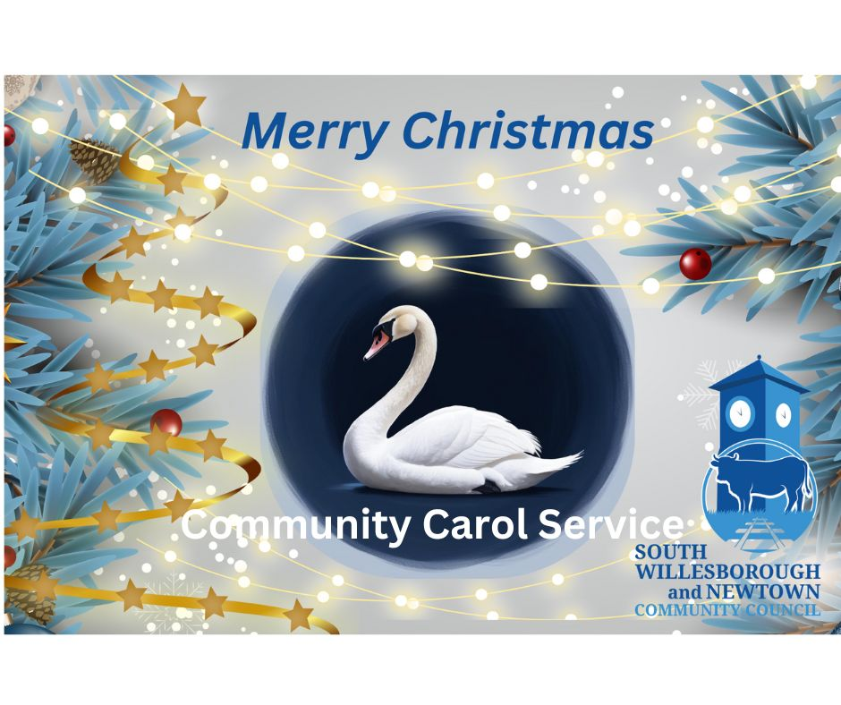
SWAN COMMUNITY COUNCIL CALENDAR OF EVENTS
March | Great British Spring Clean with Community Litter Pick
May | Annual Parish Meeting with Annual AGAR and Annual Report and Annual Health and Safety Report
May | VE Day Beacon
May | Annual Electors Meeting and Council Community Awards
July | SWAN Salute to the 1940s to celebrate 80 years of Victory in Europe and Victory in Japan an event for peace community and celebration
August | National Allotments Week Open Day
October | Pick your own pumpkin
November Onward | Spring Bulb Planting if agreed
December | Community Carols

